Slide 1
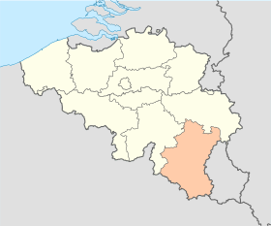
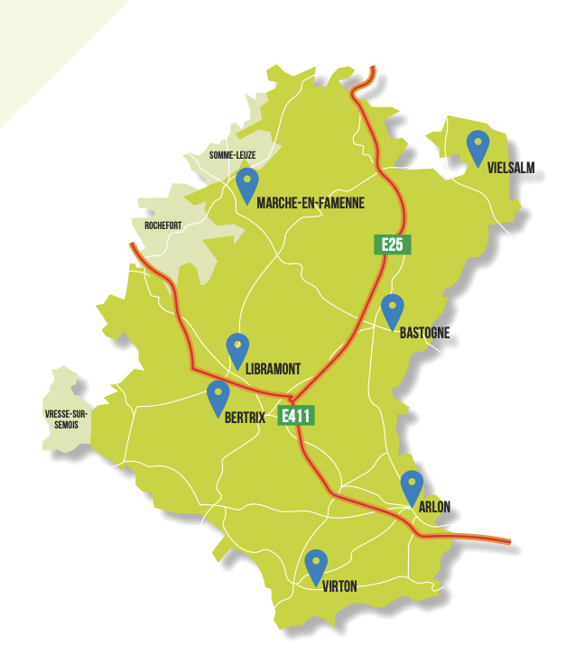
Vivalia Belgium/ First site selected
7 sites integrated in Vivalia Group
5 hospitals
2 specialized centers
GERMANY
LUXEMBOURG
FRANCE

Slide 2
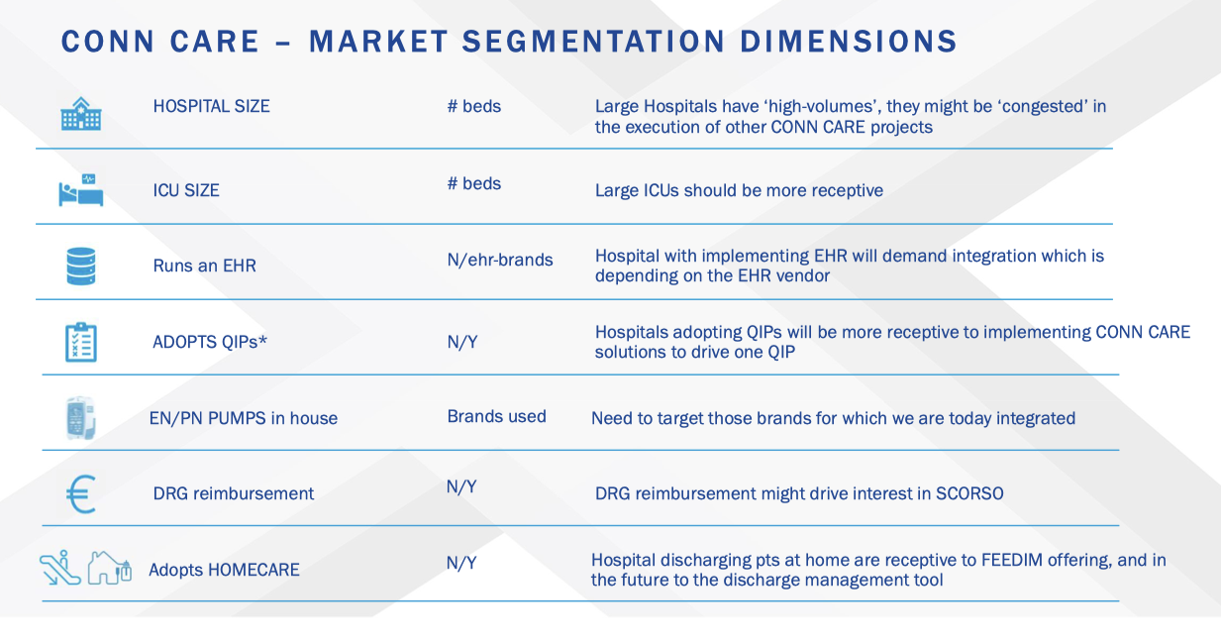
Vivalia Belgium/ First site selected
1600 beds
30 beds on 3 sites
Metavision ICU
Zorgi (Belgian EHR Leader)
Fresenius
Theoretical impact Dim3
known
Y + Remedus company

Slide 3
VIVALIA MORE DATA
Beds with agreement = 1600
Beds outside = 410
Number admissions = 46.122
Number surgeries = 28.438
Stay days Hospital = 295.541
Stay days outside hospital = 127.864
Number of consultations = 325.817
Employees = 3.778
Doctors = 426
ICU = 12 + 14 + 4 = 30 Beds on 3 sites / EHR Metavision
Remark : Patients from France

Slide 4
STATUS
- LOI signed 2/23
- Signature of installation and economical impact analysis / 23 November 2023
- Operation after scheduled kick-of before Xmas
Remark : Protocol agreement made before Baxter contract . Each part supports its costs in the defined protocol. Extra scope must be financed.
SCOPE ANALYSIS
- First : confirm impact on reimbursement using Scorso and Nutrow
- Second : define standard and individualized procedure for Dim3’s product
- Third : usability survey (Diet, Nurses, Doctors)

